Slide 1

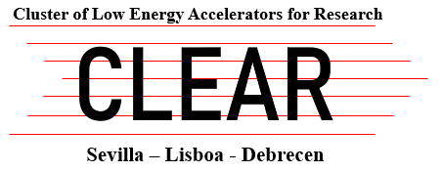
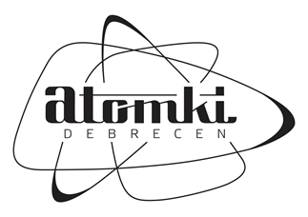

EUROLABS-CLEAR experiments at ATOMKI
2-7 November 2025
Title: Fundamental aspects of the novel ¹⁰³Pd/^{103m}Rh in vivo generator
Participants: J.R. Zeevaart
Nuclear Energy Corporation of South Africa (NECSA)
ATOMKI staff: Z. Szucs, M. Hunyadi, A.N. Laouameria, E Kurakina and the staff of the MGC-20E cyclotron
Experiments: 1 irradiation experiment with protons
Study of radiation risk by releasing ^{103m}Rh daugther radioisotope Pharmaceuticals2026, 19(1), 126;https://doi.org/10.3390/ph19010126

